Slide 1

Integrated support Tool
ReaL assistant for SuPPOrt GROUP

Slide 2
Problem Statement and requiremnts
Integrated Platform tool for Support is project which helps network or application support assistant to help his day-to-day job easier.
Give single point of console/ chat window which helps in querying CI data dependencies, health check, ansible automation, observability, RCA

Slide 3
GeN- AI Features
Knowledge Base Queries:
Leverage a vector database for efficient and context-aware information retrieval.
Unified Data Access: Query across diverse data sources in real-time:
Content
Configuration Items (CI) Data
Incidents
Application Dependencies
Agentic Root Cause Analysis:
Intelligent agents analyze relevant logs to pinpoint the root cause of issues.
MCP Utility & Automation:
Dedicated MCP server for server health monitoring.
Trigger Ansible automation scripts for remediation

Slide 4
Technologies
UI : HTML, CSS, js
Python 3.0 Ollama(model = ""llama3.2") –
Local LLM
Lang Chain : chaining prompts
Lang Graph : to construct Workflows MCP servers,
Agents , Tools, vector store - sin/cosign

Slide 5
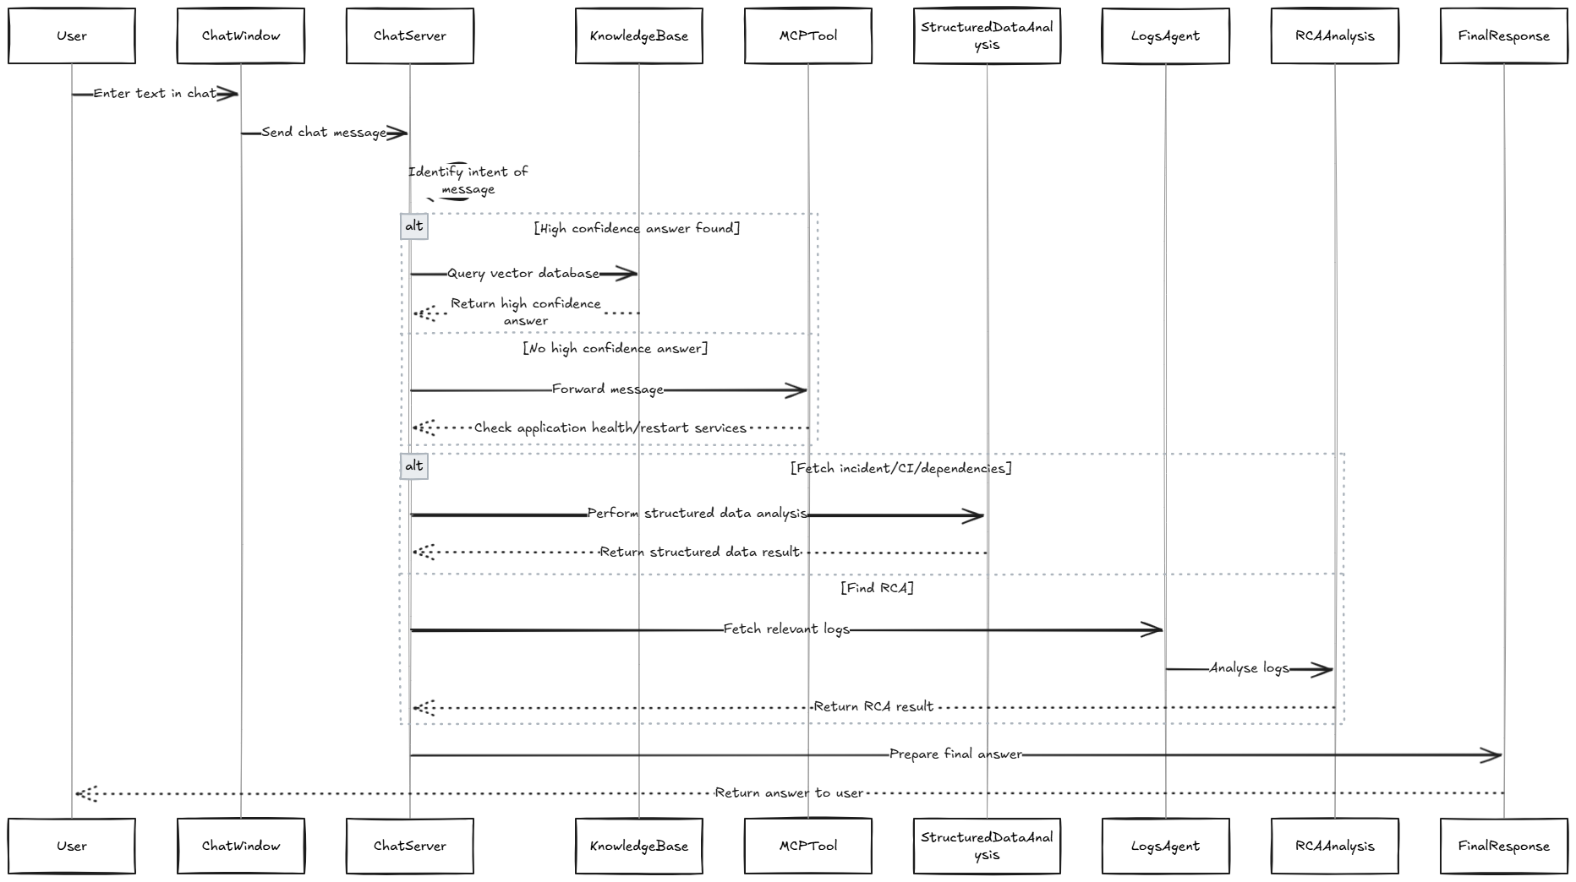
Flow Diagram

Slide 6
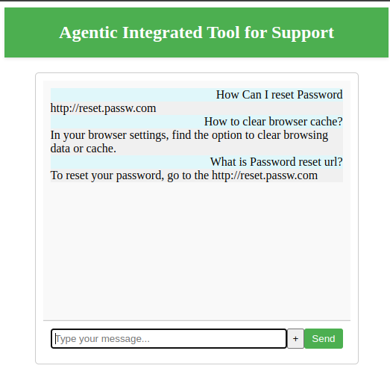
Use Case 1- knowledge Base
ALL FAQ questions and Important articles are pre stored in Vector DB.
Then similarity of User message and Messages in vector db are compared using sine and cosine functions
If similarity has more that 0.4 (current value set). Considered as Final answer.

Slide 7
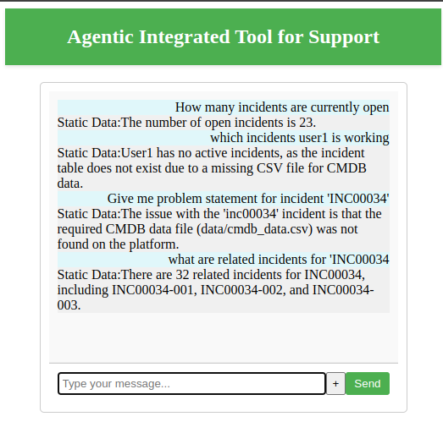
Use case 2: Understand Structured data
Data sets which are structured like one in json , csv or jsonl file or data coming from DB queries has many information which Support person might need to infer.
In our example I have considered Incidents, CI data, their dependencies as structued data.
These data sets are minimum in size and hence can be loaded as Data frames and answered by LLM with proper prompt.

Slide 8
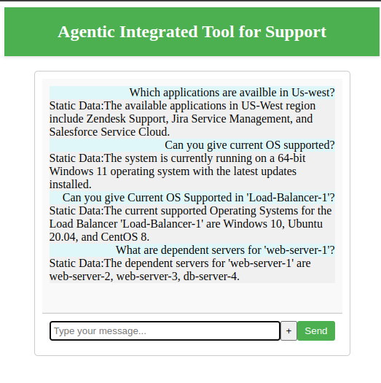
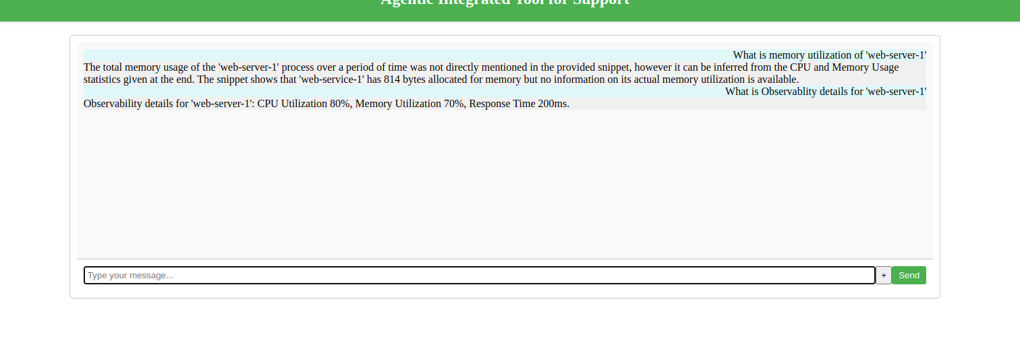
Use Case 2 Continued

Slide 9
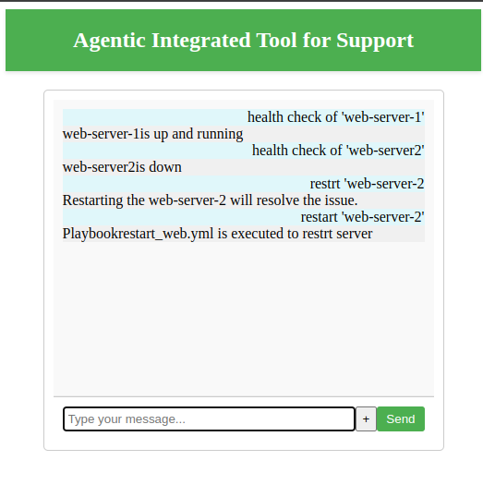
Use case 3 – Getting data from External Systems (MCP)
Few Systems are External systems , like a website or few scripts that we might need to run by logging in to system.
These systems are important as they are feting data or performing action at real time.
In our use case Health check server is an external hosted server which gives real time info on how apps are doing and also ansible automation scripts are used to start and stop server.
These external resources are bound as Tools in the MCP servers. In our example MCP server is our inbuilt server which gives details on which tools its support and hence client can decide to use which one to call dynamically based on use case.

Slide 10
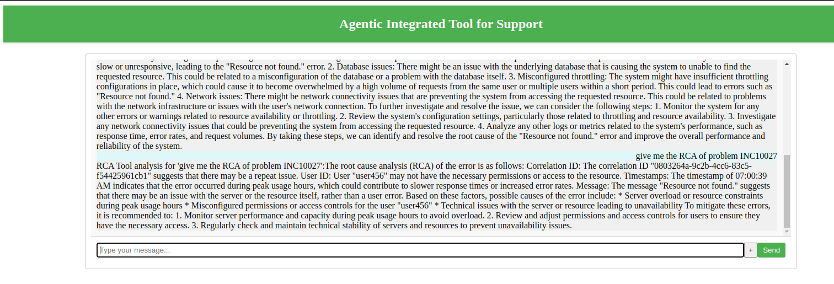
Use case – 4 : Chaining prompts
Some use Cases require chaining of multiple prompts for example Using splunk logs if we need to find RCA, we might need to find related logs based on filter condition and second prompting will be to summarize RCA. This chaining of prompts are show cased here.

Slide 11
CHALLENGES
Non Technical:
Understand Support system use cases and the data they will be dealing on day to day basis
Technical challenges
new to Python ,
new to AI and LLM
making individual tools/ agents work together as workflow. (Lang Chain and Lang Graph)

Slide 12

Thank You!
someone@example.com

Slide 13
Improvements
UI :
1) Give + button working to include and file to context
2) Give Mike symbol to give voice over access
Model:
Keeping conversation in memory.
Better Workflows by deriving import information in each steps and saving as state.
Improve data sets to train better

